Slide 1
User Education
Tam Nguyen

Slide 2
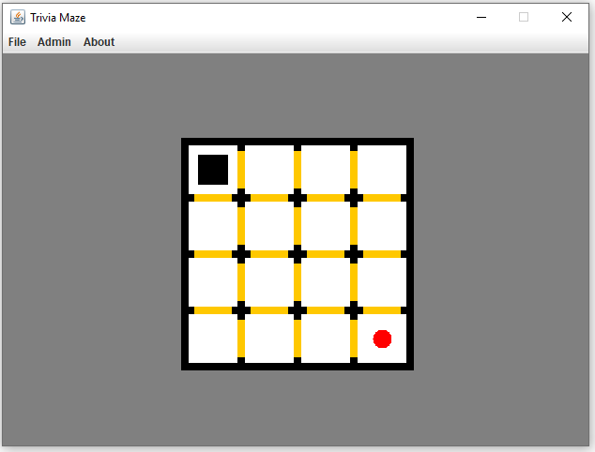
Game: Trivia Maze

Slide 3
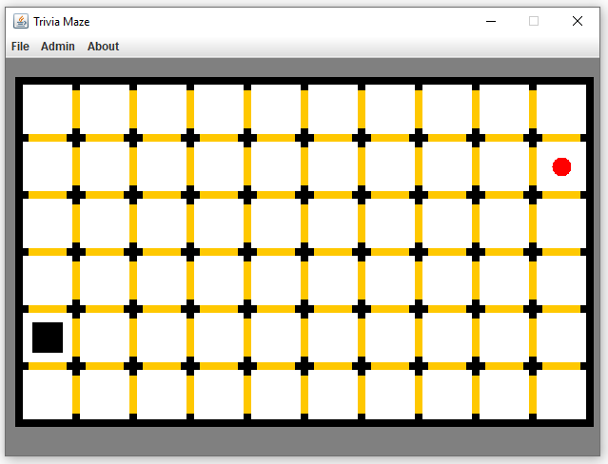
Game: Trivia Maze

Slide 4
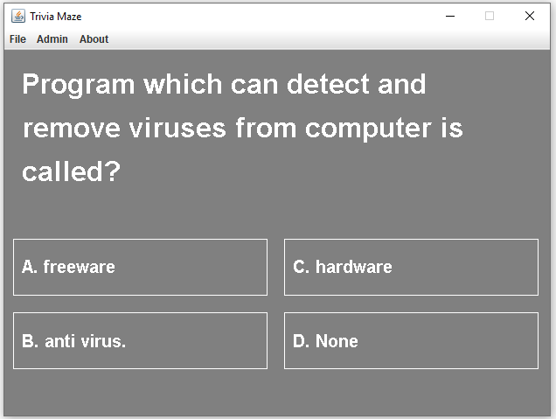
Game: Trivia Maze

Slide 5
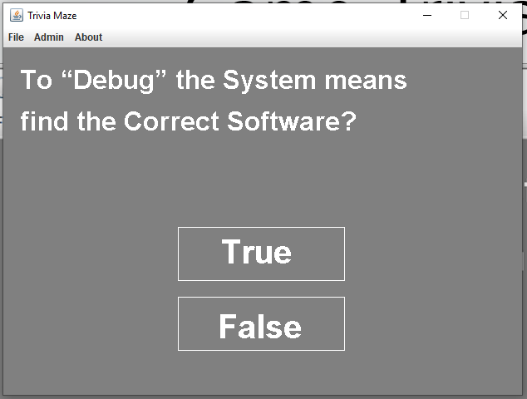
Game: Trivia Maze

Slide 6
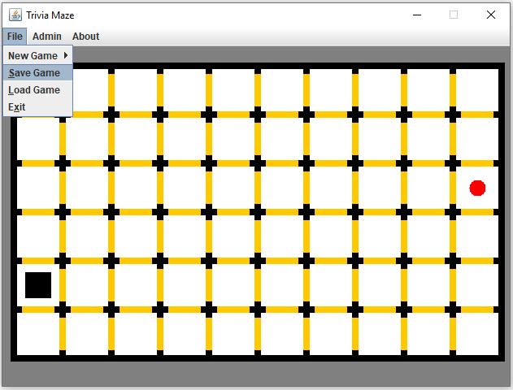
Game: Trivia Maze

Slide 7
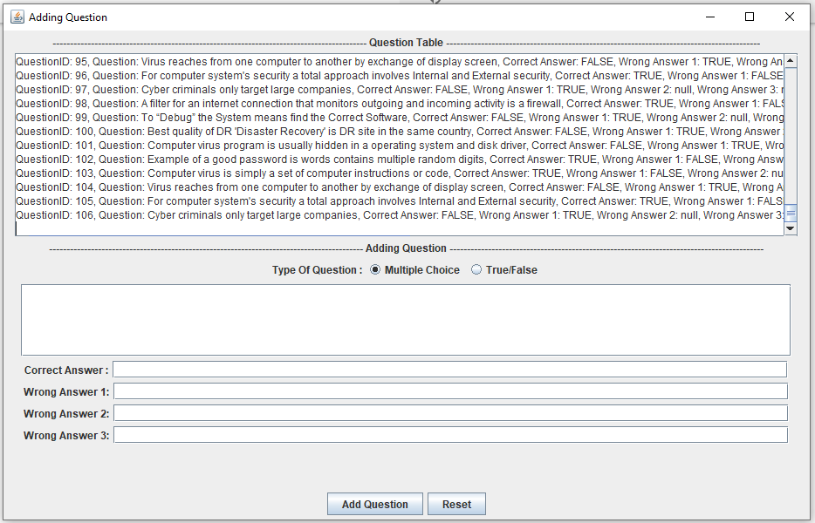
Game: Admin Window

Slide 8
User's reactions.
There are 10 people played Trivia Maze
Only 2/10 players pass easy level for the first try.
8/10 players pass easy level
4/10 player pass hard level
10/10 players try more than 3 times

